Slide 1
Scientific Data Visualization

Slide 2

What is Data Visualization? and Why Visualize Data?

Slide 3
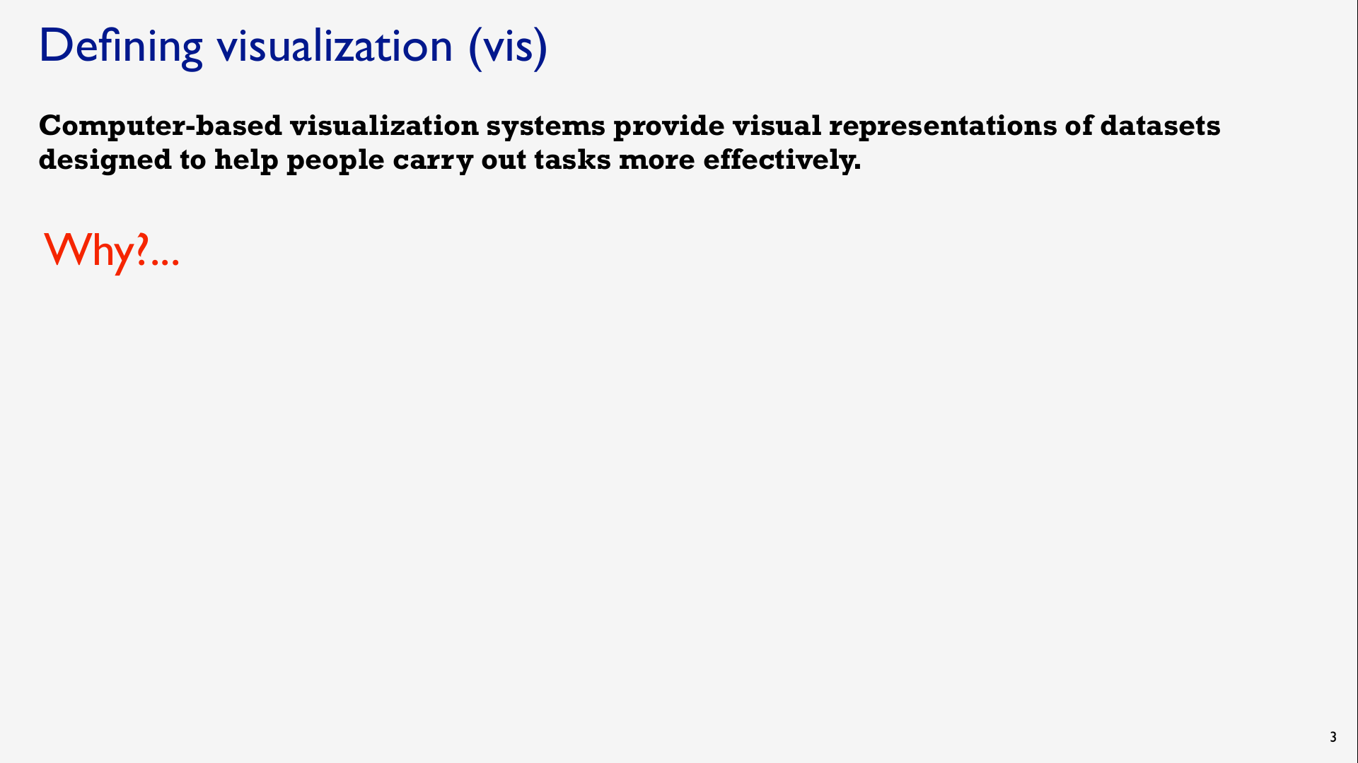
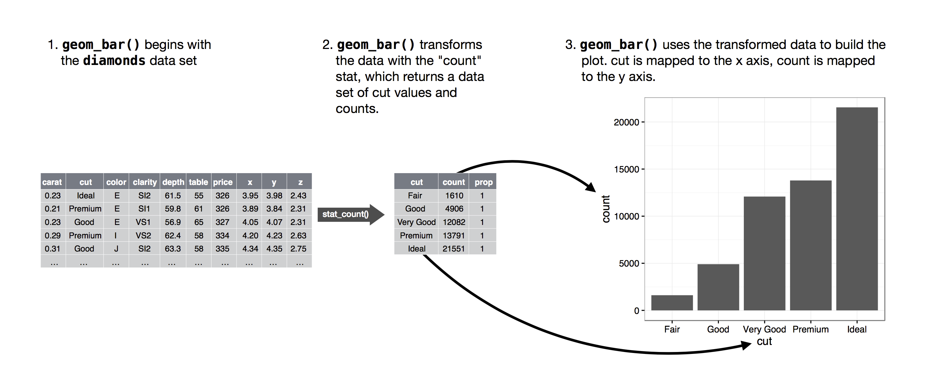

Slide 4
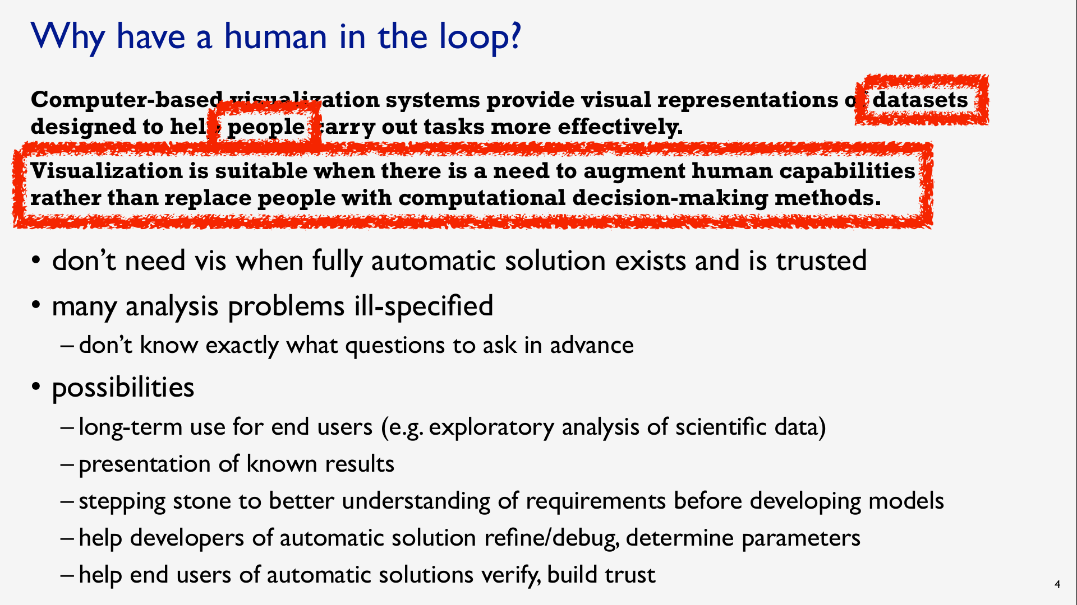

Slide 5
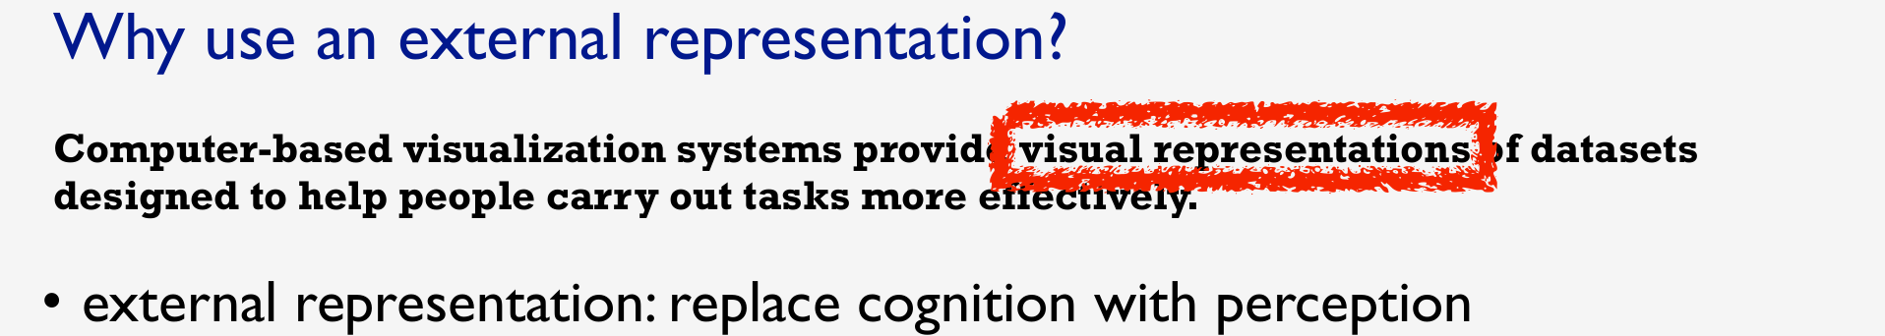
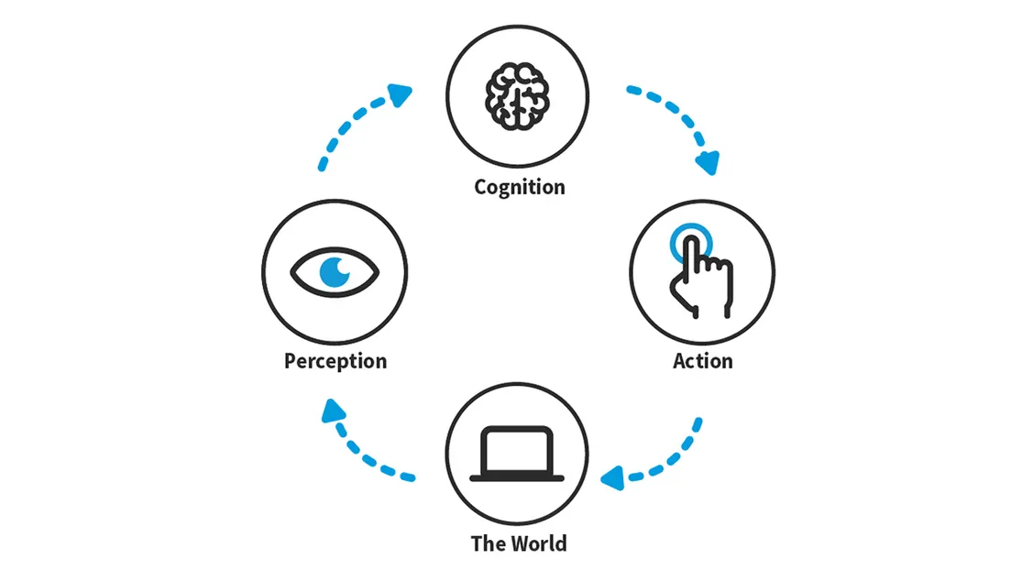

Slide 6
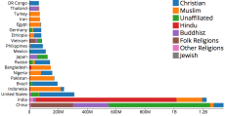
Example: Religions by Country
Which country has the most Hindus?
https://gist.github.com/curran/0d2cc6698cad72a48027b8de0ebb417d#file-religionbycountrytop20-csv

Slide 7
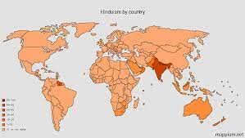
Example: Religions by Country
Which country has the most Hindus?
https://vizhub.com/curran/ef717a89e37a4d9285cebfa904790665

Slide 8
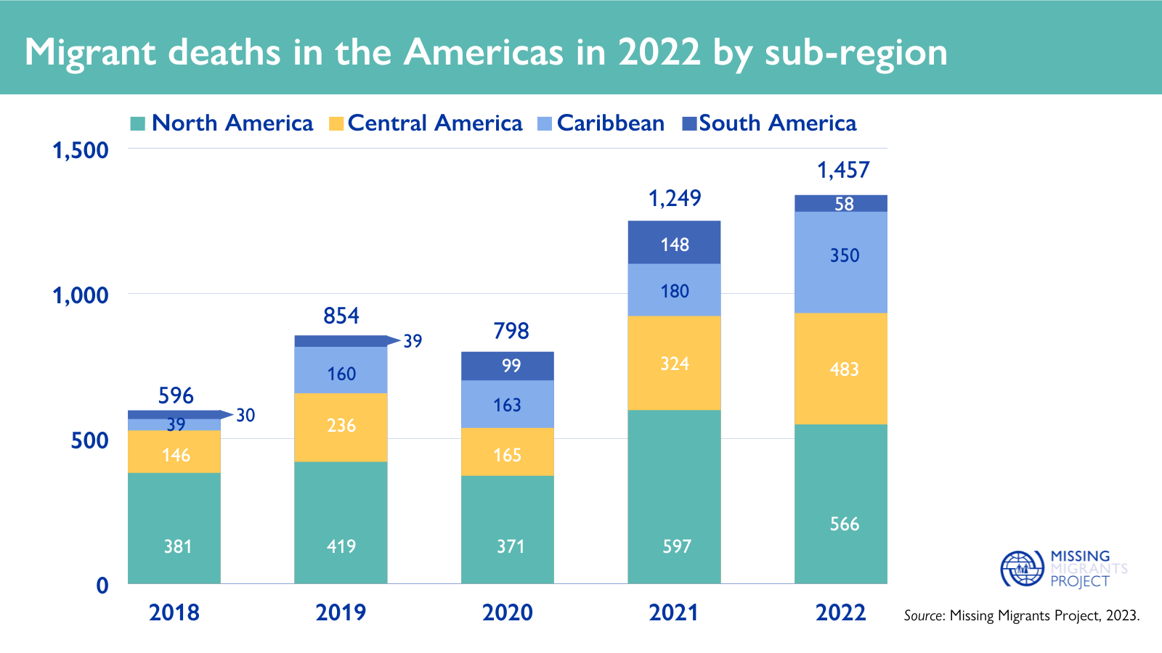
Example: Migrant Deaths
When and where did migrant deaths occur?
Are there any patterns or trends?
Stacked Bar chart

Slide 9

Finding Visualizations
https://flowingdata.com/
https://fivethirtyeight.com/tag/data-visualization/
https://pudding.cool/
https://www.economist.com/graphic-detail
https://observablehq.com/explore

Slide 10
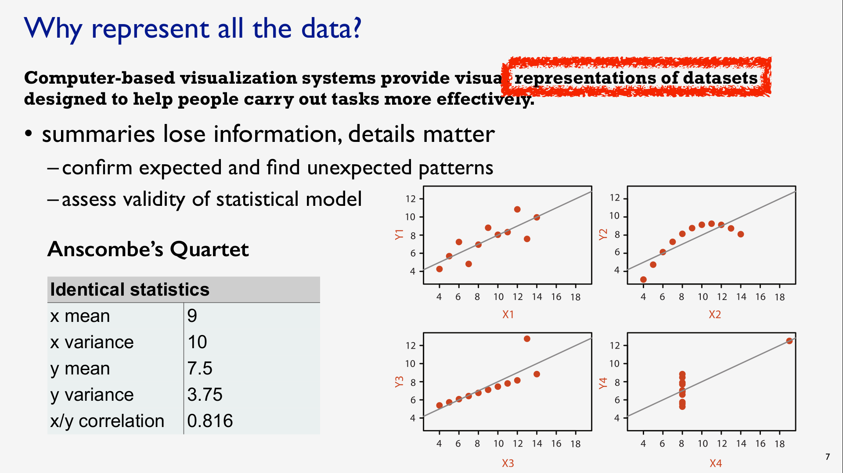

Slide 11
Input for Visualization
Data and Tasks

Slide 12
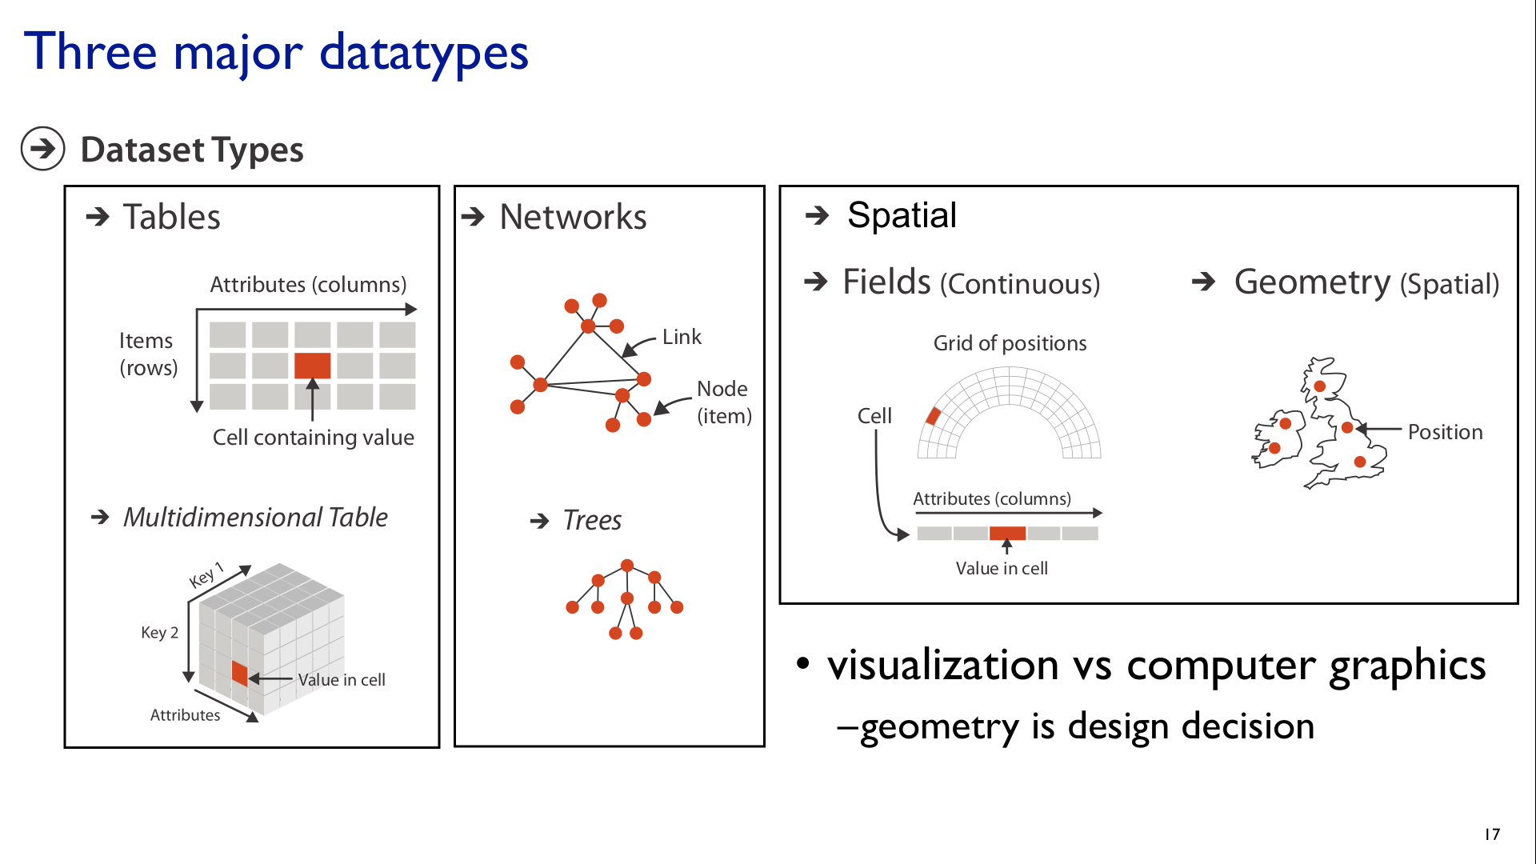

Slide 13
Attribute Types
Broad taxonomy for visualization design

Slide 14
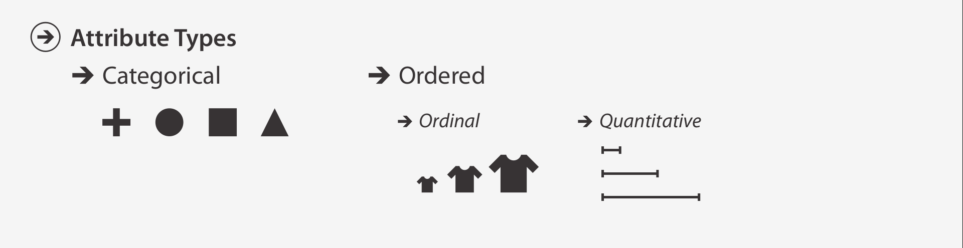

Slide 15
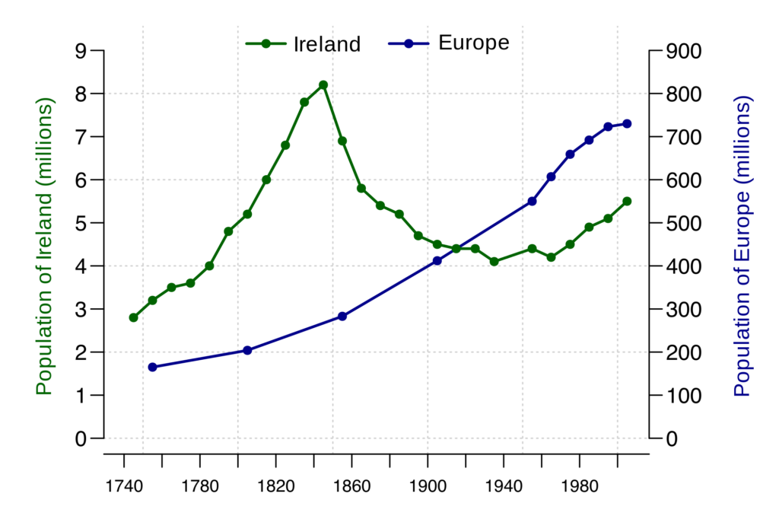
Special Cases
Time
Point in time
Region of time
Space
Point in space
Region of space

Slide 16
 | Point | Region
Space
Time
Quantity
(Latitude, Longitude)
e.g. “My current location”
Geographic Identifier e.g. Countries, States, Counties
Quantitative
Categorical
Instant
e.g. “Right now”
Interval
e.g. “This year”
Quantitative
Ordinal
Value e.g. 5.2
Interval
e.g. “5 - 10 years old”
Quantitative
Ordinal

Slide 17
Introduction to Web Technologies
Why use this platform?

Slide 18

We’ll discuss
Why use Web Technologies?
What are Web Technologies (HTML, JavaScript, CSS, SVG)?
What is a JavaScript Library?
Why use D3 to make data visualizations?

Slide 19
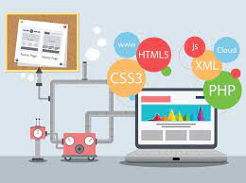
Why use Web Technologies?
Accessible by anyone with a Web browser
Easy to use; No need to install anything locally
Advanced technology
Affords customizable, bespoke work
Unlimited potential for adding interactivity

Slide 20











Web Technologies
Libraries
Frameworks

Slide 21
What is a JavaScript Library?
JavaScript is one of the most widely used programming languages where it operates on creating interactive UI that displays dynamic content.
JavaScript libraries are a collection of prewritten code snippets that can be used or reused to perform common functions.
The web component-based library allows developers to avoid pitfalls of rewriting code and dealing with complicated debugging.

Slide 22
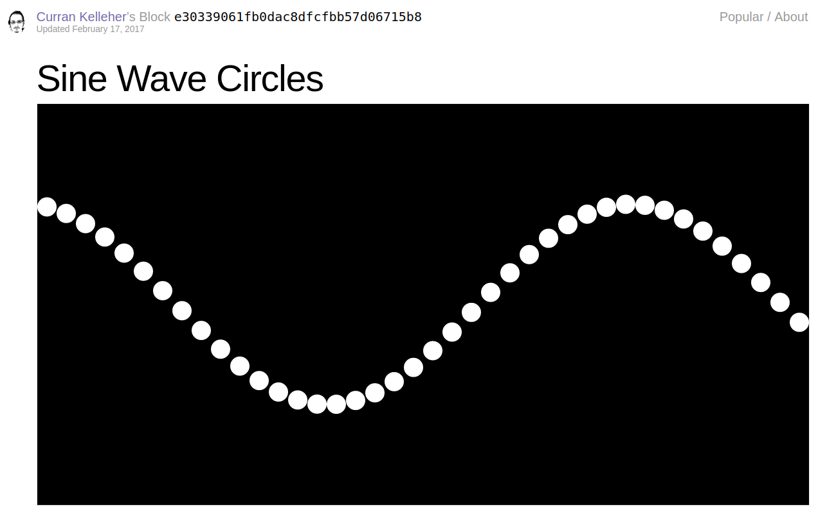
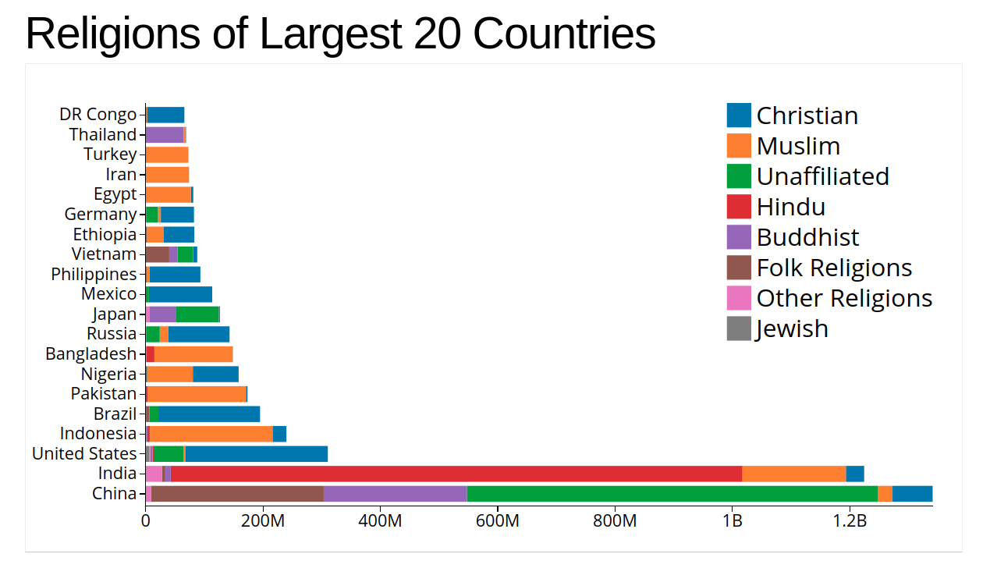
JavaScript Examples
vizhub.com/curran

Slide 23
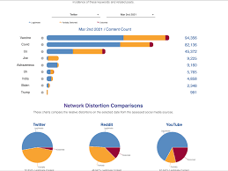
D3
D3 is an open source JavaScript library and framework for creating visualizations.
It creates visualizations by binding the data and graphical elements to the document object model.
It can be integrated into Javascript, React, Angular etc..
It has become extremely popular for making high end landing pages.

Slide 24
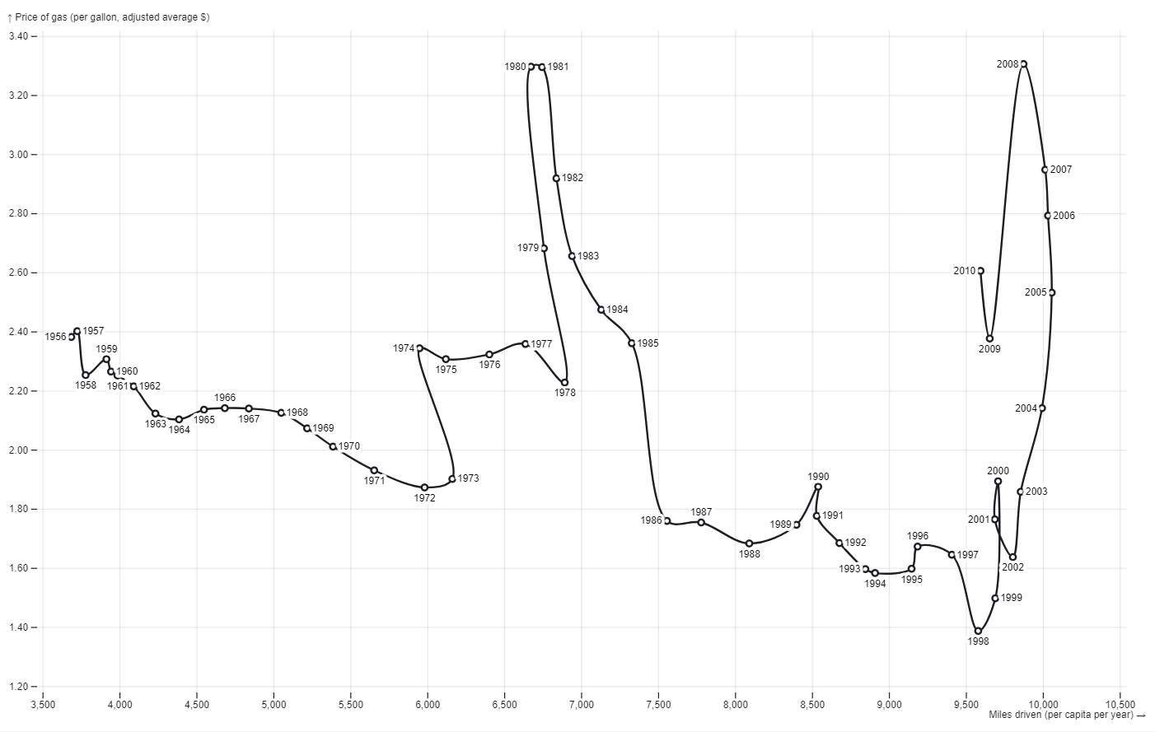
D3
D3 or D3.js is one of the most popular data visualization library.
D3 gallery has veritable zoo of forms like Treemap, Force-directional graph, etc…
D3 is also known for its animation capabilities that helps us to animate bar charts or treemaps.

Slide 25
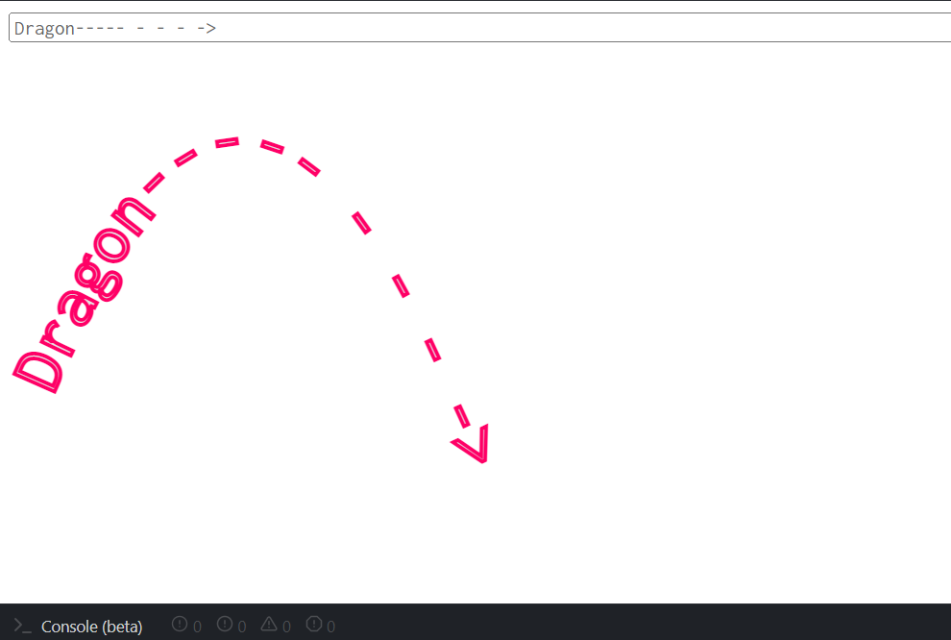
SVG
SVG is a fast and lightweight library for manipulating and animating SVG.
It has no dependencies and aims to be as small as possible while providing close to complete coverage of the specs.
It provides a syntax that is concise and easy to read.

Slide 26
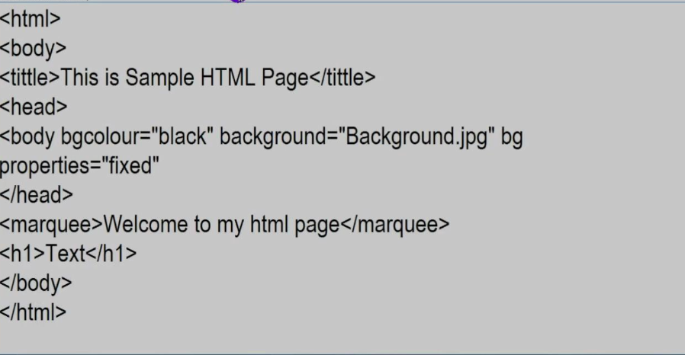
HTML
HTML stands for Hypertext Markup Language, which is most widely used language on web to develop web pages.
HTML was developed with the intent of defining the structure of Documents like heading, paragraphs, lists.
The <!DOCTYPE html> tag tells the web browser that is an HTML document.
<html> </html> tag marks the beginning and end of HTML document.
<head> contains metadata and <body> consists of the content.

Slide 27
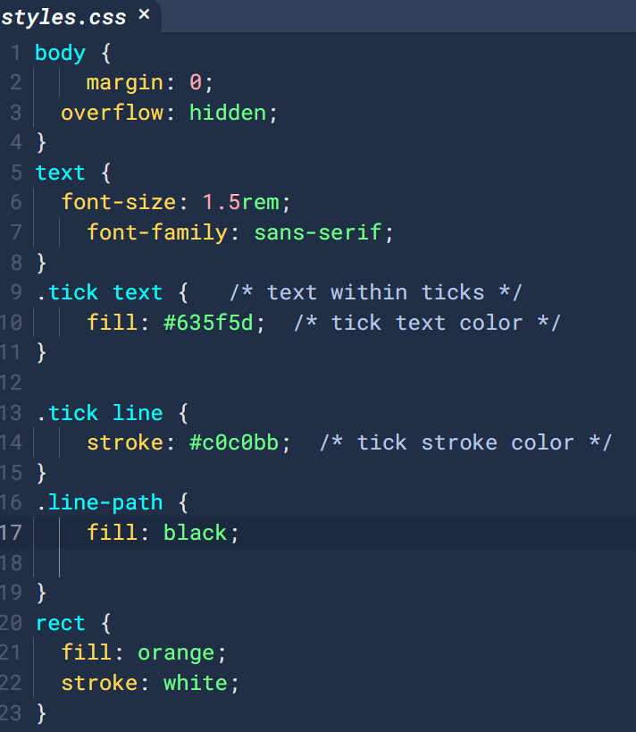
CSS
CSS is a style sheet or presentational language that is used to layout, format and style document that are written in HTML to make them look beautiful.
CSS is generally used with HTML to change the style of web pages and UI.

Slide 28
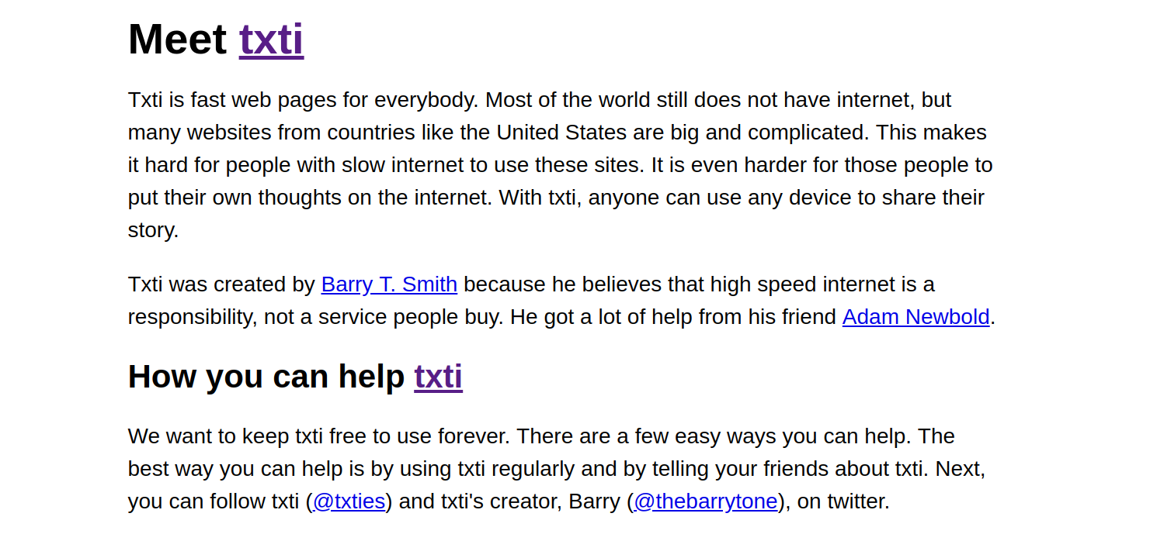
http://help.websiteos.com/websiteos/example_of_a_simple_html_page.htm

Slide 29
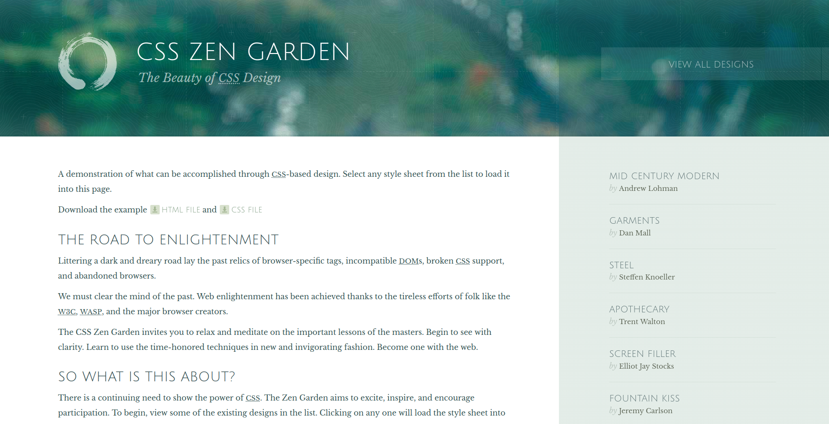

Slide 30
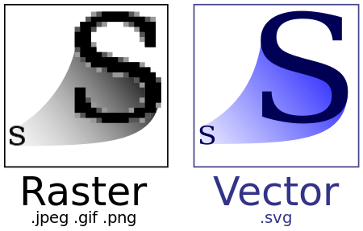
Raster graphics: ”It is made up of tiny squares called pixels. They are good for photos and images with lots of detail, but they can lose quality when you zoom in"
Vector graphics: ”These are made up of mathematical paths and points. They are good for logos, icons, and illustrations, and they can be scaled to any size without losing quality."

Slide 31

Python Libraries

Slide 32
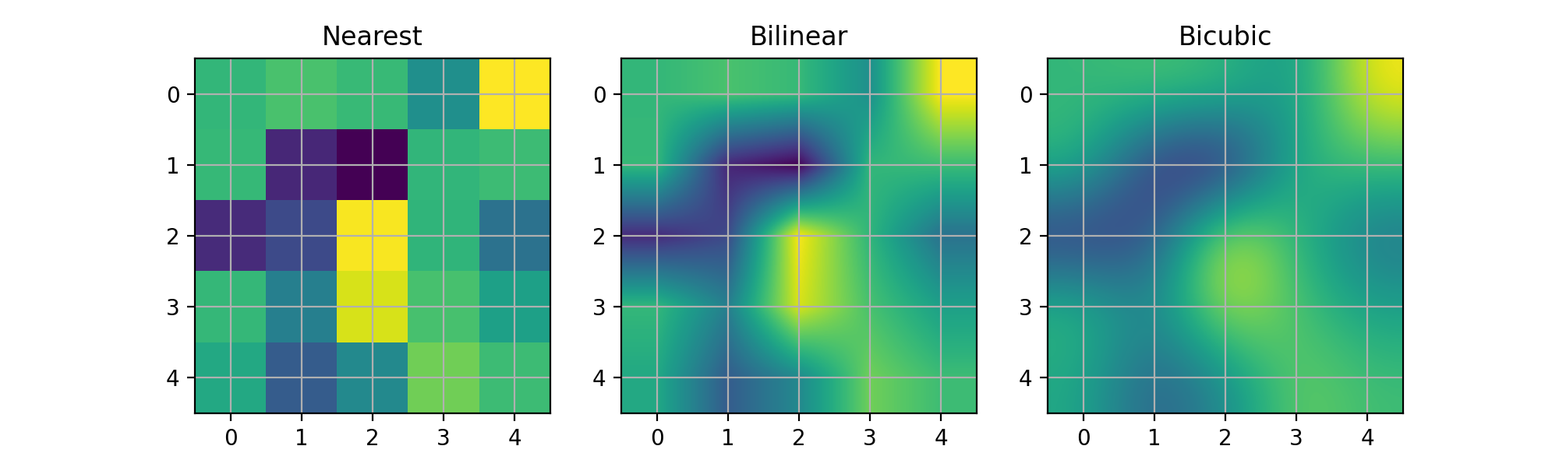
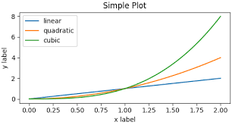
Matplotlib
Matplotlib is a comprehensive library for creating static, animated and interactive visualizations in python.
Matplotlib computes the interpolation and resizing on the padded array and then extracts the central region of the result.

Slide 33
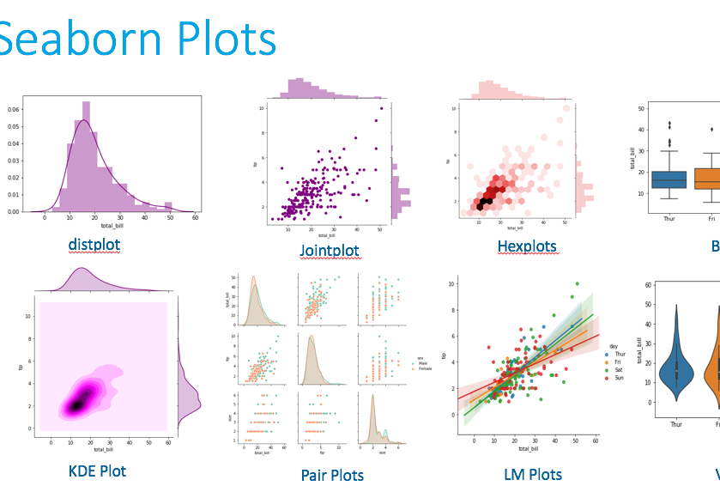
Seaborn
Seaborn is a library for making statistical graphics in python.
It builds on top of matplotlib and integrates closely with pandas data structures to perform exploratory analysis.
Seaborn helps us to visualize univariate and bivariate data.

Slide 34
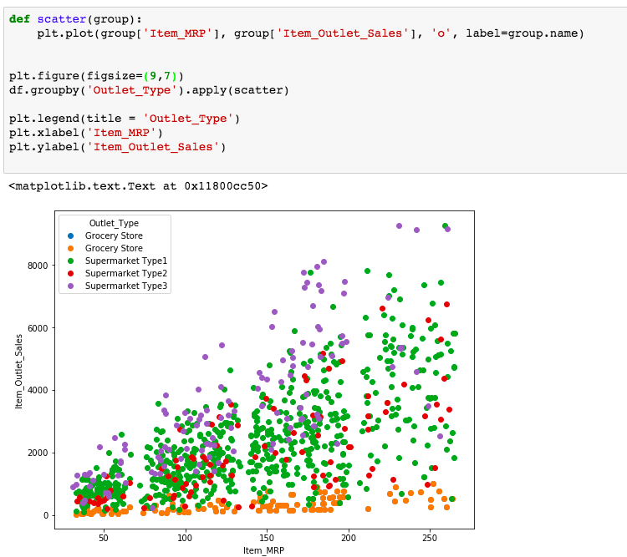
altair
It is a statistical visualization library in python.
The user only needs to specify how the data columns are mapped to the encoding channel.
Faceting and interactivity are very easy to implement.

Slide 35

Introduction to Tableau
Why use this platform?

Slide 36
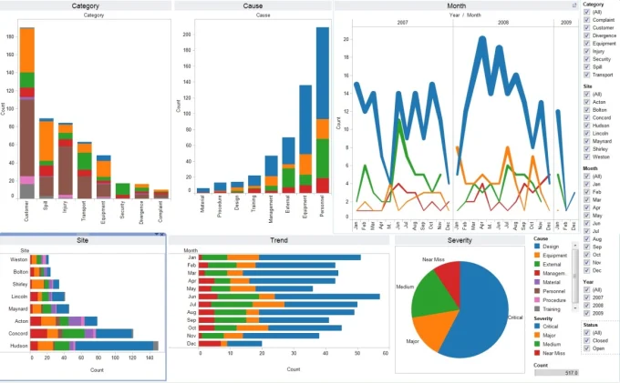
What is Tableau?
Tableau is a business intelligence software
Any user can connect to Tableau and perform analysis and reporting very efficiently and accurately.
Tableau is easy to use as MS-excel, so that any user can solve complex analytical problems without any prerequisites.

Slide 37
Click on the link to download tableau
https://public.tableau.com/en-us/s/download

Slide 38
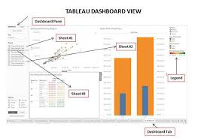
Tableau
Tableau is the most robust, secure, and flexible end-to-end analytics platform for your data, and it is the fastest-growing data visualization tool used in the Business Intelligence Industry
Data analysis process is very fast with Tableau, and the visualizations created are in the form of dashboards and worksheets.

Slide 39
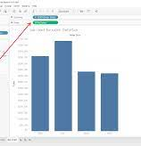
Bar Graph
A bar graph shows shows comparisons among discrete Categories.
One axis of the chart shows the specific categories being compared, and the other axis represents a measured value.

Slide 40
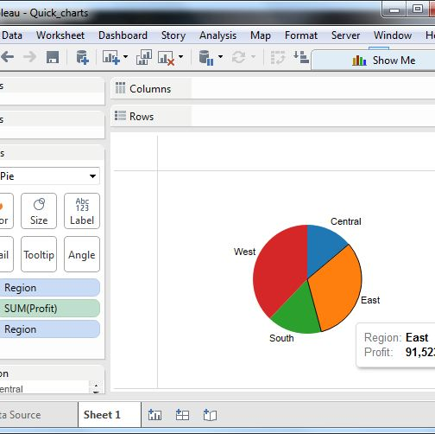
Pie chart
If you have several parts of something whole, you can demonstrate in one pie chart.
In a pie chart, the area of each slide is proportional to the quantity it represents.

Slide 41
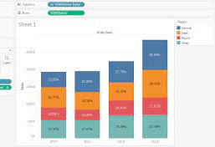
Grouped Bar Plots
A grouped Bar Plots is used for more complex comparison of data.
Each group can be plotted side by side, or stacked on top of each other.

Slide 42
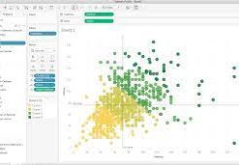
Scatter plot
Scatter plots are used for examining relationships between two types of data. The dots are not connected in a scatter plot, though a best fit or regression line may be used to illustrate the relationship.

Slide 43

Introduction to PowerBI

Slide 44
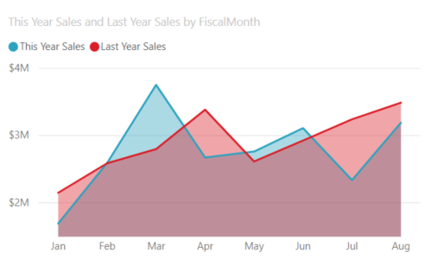
Area charts
The basic area chart is based on the line chart with the area between the axis and line filled in.
It emphasize the magnitude of change over time, and can be used to draw attention to the total value across a trend.
Ex:- The data represents profits over time can be plotted in an area chart to get the total profit.

Slide 45
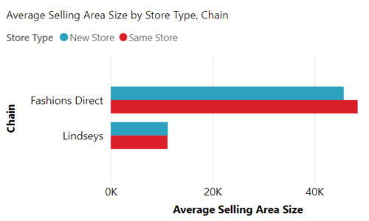
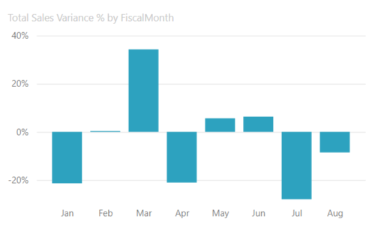
Bar and column charts
Bar charts are the standard for looking at a specific value across different categories.
Ex:- the chart shows us the average sales of the store with respect to the chain of stores.

Slide 46
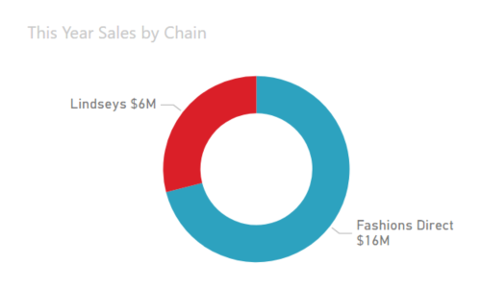
Doughnut Chart
Doughnut charts are similar to pie charts. They show the relationship of parts to a whole.
The only difference is that the center is blank and allows space for a label or icon.

Slide 47
Visualization Analysis and Design by Tamara Munzner
Textbook Reference:-

